Slide 1

GrPC – Rest api - cache make faster requests & response

Slide 2

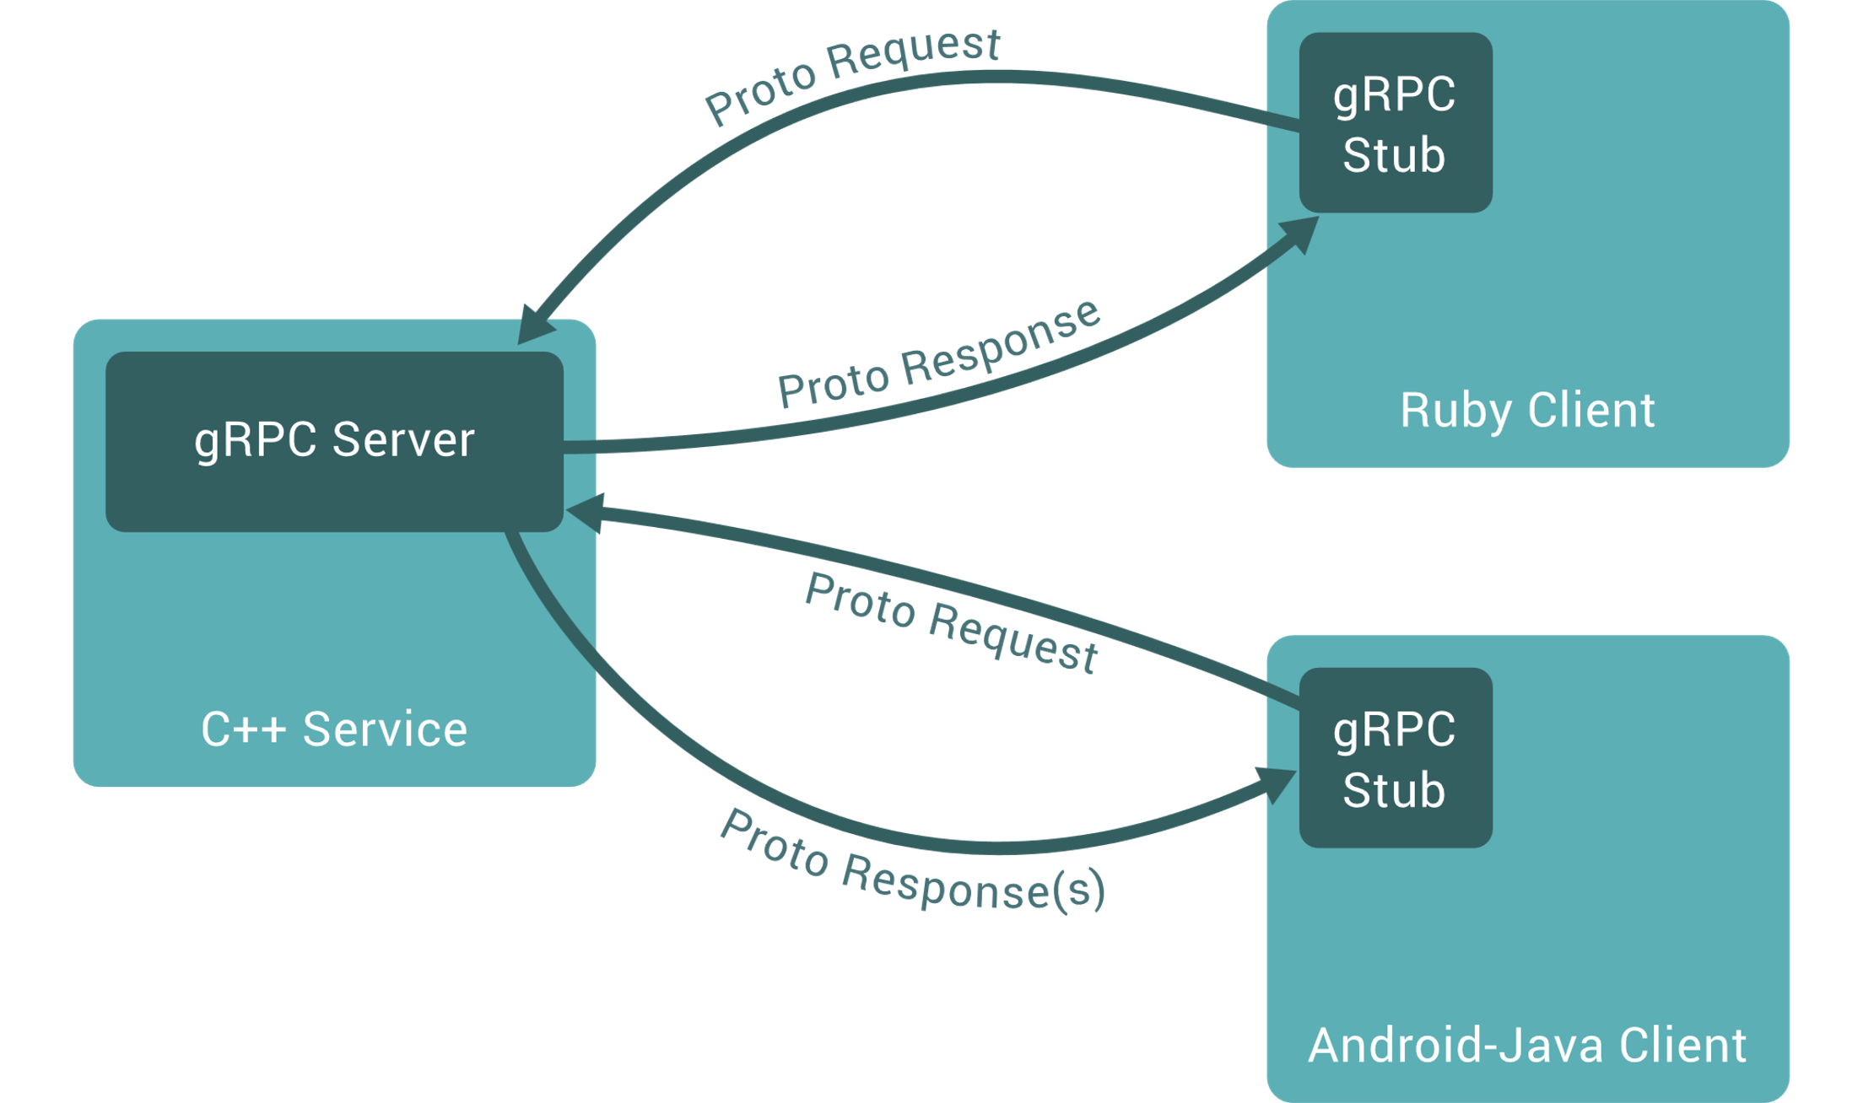
What is gRPC?
gRPC is a modern open source high performance Remote Procedure Call (RPC) framework that can run in any environment. It can efficiently connect services in and across data centers with pluggable support for load balancing, tracing, health checking and authentication. It is also applicable in last mile of distributed computing to connect devices, mobile applications and browsers to backend services.

Slide 3
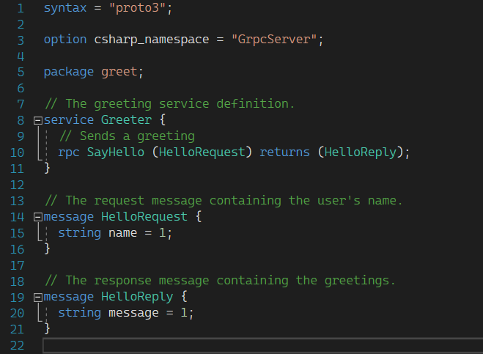
General specifications Proto
Functions
Models : Responeses Requests

Slide 4
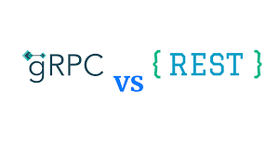
Characteristic | gRPC | REST API
HTTP Protocol | HTTP 2 | HTTP 1.1
Messaging Format | Protobuf (Protocol Buffers) | JSON (usually) or XML and others
Code Generation | Native Protoc Compiler | Third-Party Solutions Like Swagger
Communication | Unary Client-Request or Bidirectional/Streaming | Client-Request Only
Implementation Time | 45 Minutes | 10 Minutes

Slide 5
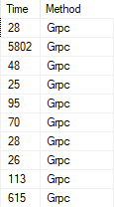
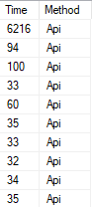
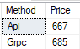
Compare grpc-Rest
This is a small test in real example behavior. In this test I call the server in 10 iteration loop with 10 second delay per request.I Set a clock for every request and estimate the request by clock. You can see the results in image :

Slide 6

grpc or rest?
With these tests and implementations , as a developer , GRPC need more time to create and implementation than REST.
Debugging and refactoring the GRPC is not simple.
GRPC is a bit faster in our scenario.
GRPC documents and protos needs to sync every time.
GRPC is useful for IOT and microservice application and limited bandwidth connections

Slide 7

My Opinion? cache
There is another way and solutions for make faster request.
We can use and implement CACHE system.
There is a lot of way for this case. I want to use the best way due to the architecture and current tools.

Slide 8
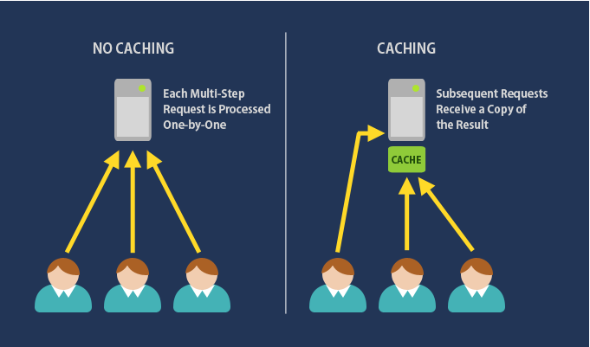
the two main types of caching ASP.NET Core are :
In-memory caching
An in-memory cache is stored in the memory of a single server hosting the application. Basically, the data is cached within the application. This is the easiest way to drastically improve application performance.
Distributed Caching
Distributed cache is a cache that can be shared by one or more applications and it is maintained as an external service that is accessible to all servers. So distributed cache is external to the application.

Slide 9
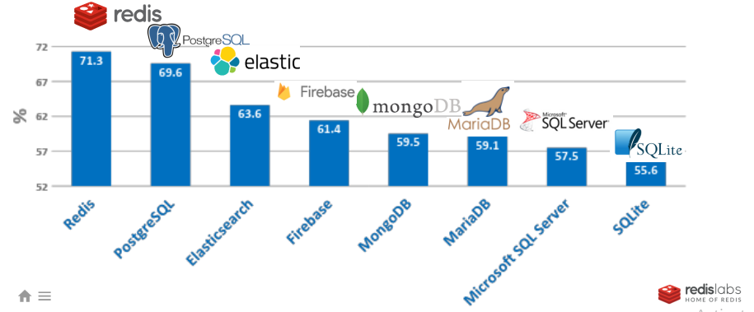
REDIS DB
Redis is a fast in-memory database and cache, open source under a BSD license, written in C and optimized for speed. Redis’ name comes from “REmote DIctionary Server”. Redis Is FASTEST, Free, Easy To implement, a lot of tools and features.

Slide 10
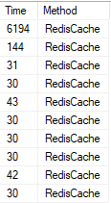
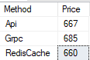
I Also made test for REDIS
TEST on Redis.
In this test I prepared that test on REST and GRPC with same DB , same Computer.
You can see the result :
Avarage

